Slide 1

Persecution and Cover-Up
Judy A. Mikovits, PhD

Slide 2
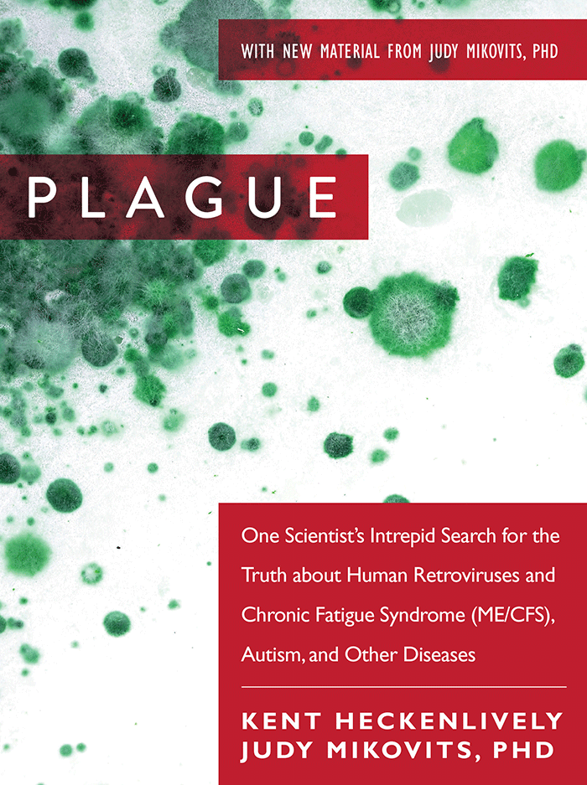
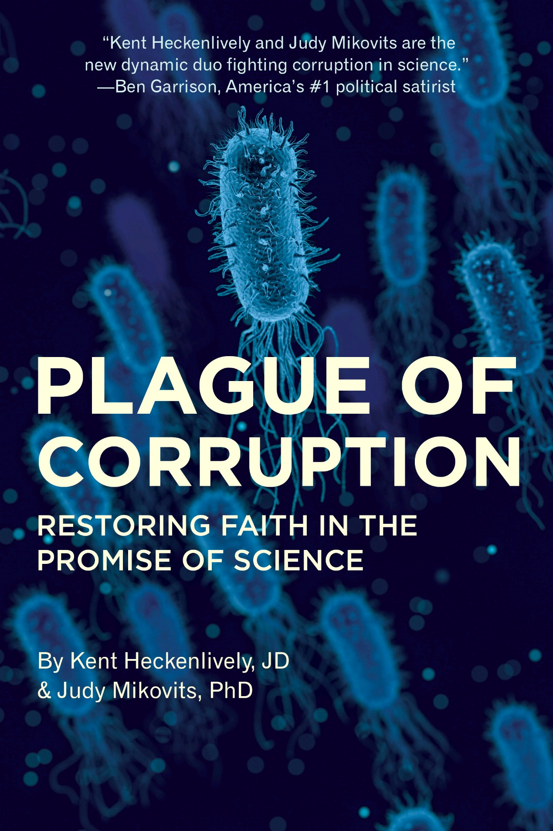

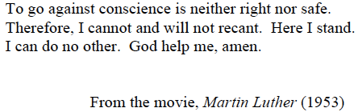
www.plaguethebook.com
M.A.R.C. Inc.
Carlsbad, CA

Slide 3
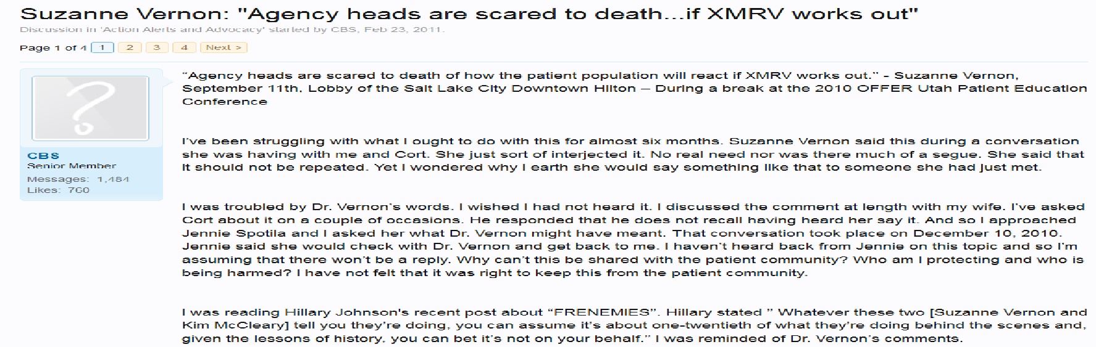
September 11, 2010
Why? Because in 1991 ONE million Americans were Infected with HIV
in 2010 when studies showed between 10-25 Million Americans were infected with XMRVs
which likely got into humans via contaminated blood and vaccines

Slide 4
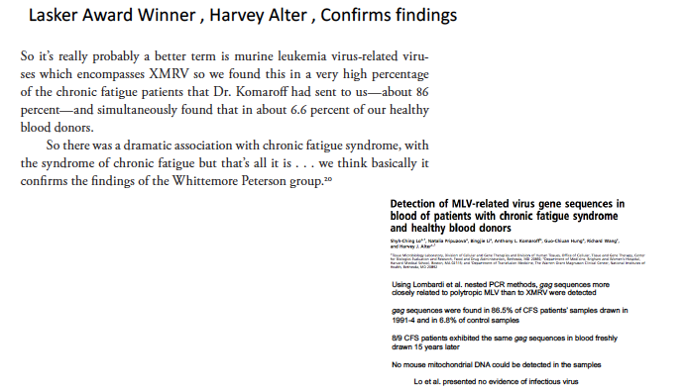
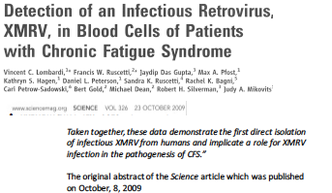
Solution for Agency Heads to 2009 and 2010 Publications of XMRVs
strongly associated with ME/CFS in Elite Journals?
Force authors to destroy the data
Force authors to withdraw the paper
Journal Retracts Paper (implying fraud)
In 2011 Harvey Alter picked the poison to have this 2010 confirmatory study withdrawn

Slide 5
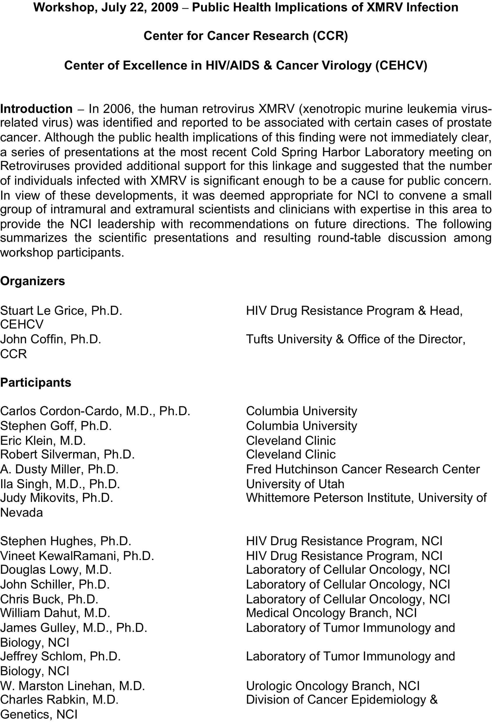
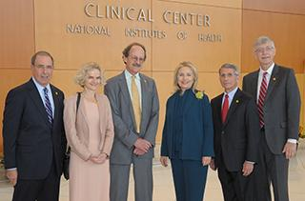
WHO & WHY?

Slide 6
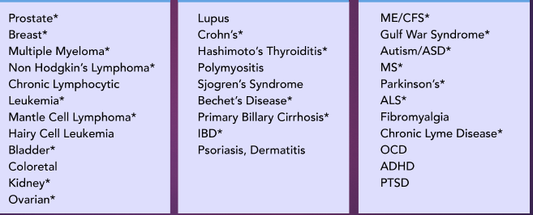
21st Century Acquired Endocannabinoid Immune Dysfunction:
Unintended? Consequences of Unsafe Vaccinations & CDC Schedule
Diabetes
Cardiovascular Disease*
Neuroendocrine tumors*
Psychosis*

Slide 7
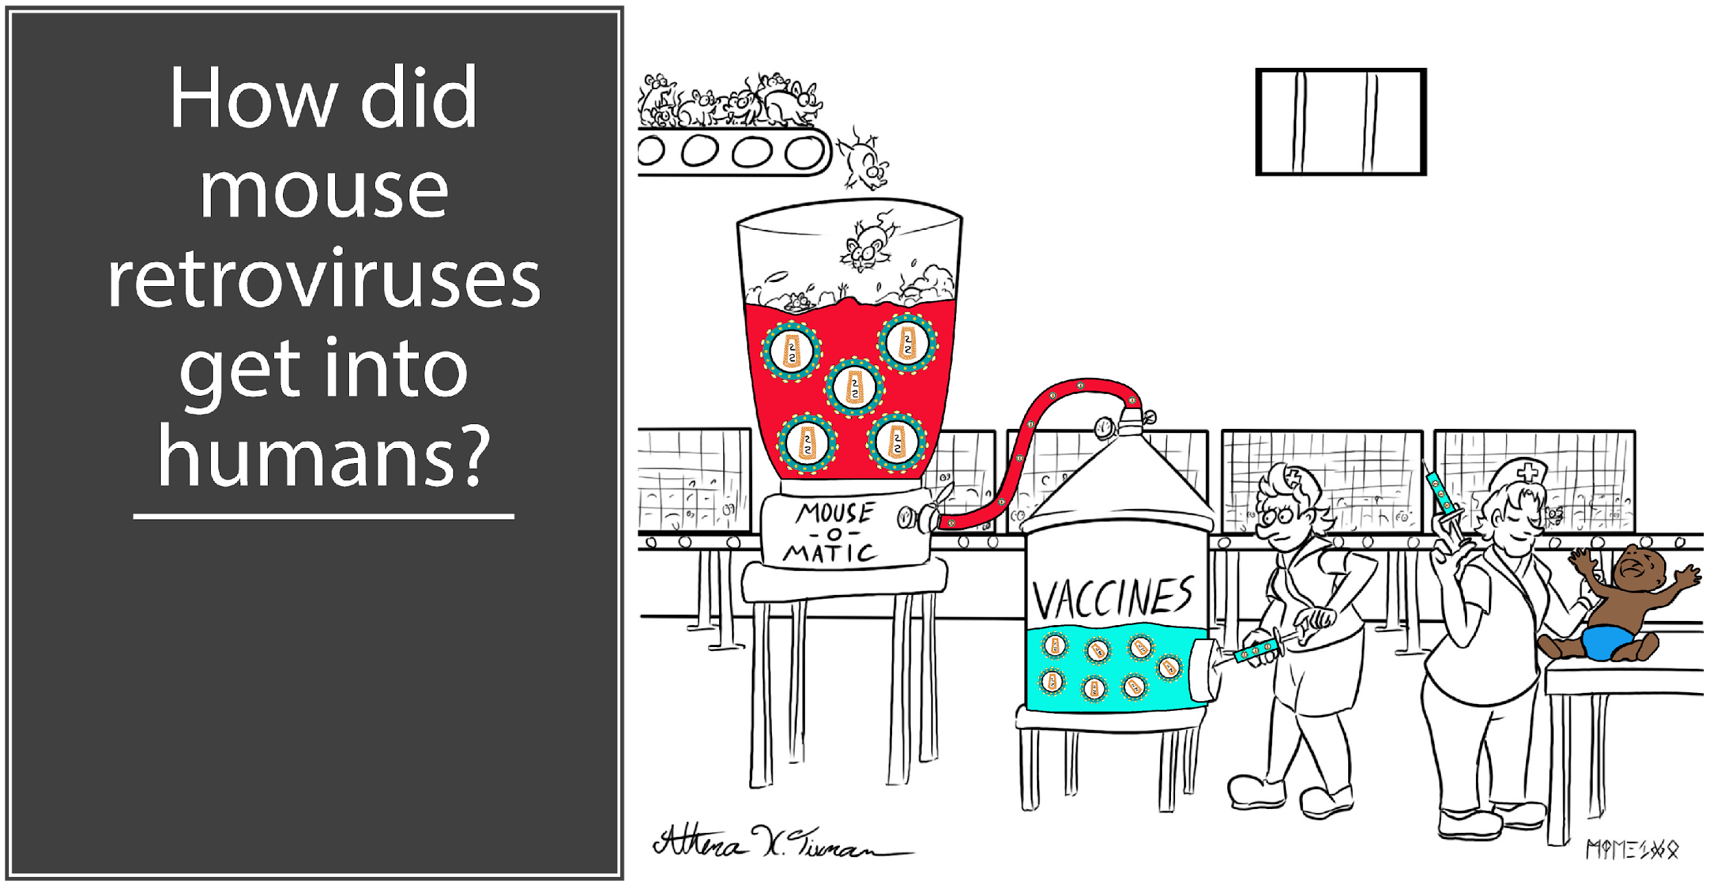
“One of the most widely distributed biological products that frequently involved mice of mouse tissue, at least up until recent years, are vaccines, especially vaccines against viruses . . . It is possible that XMRV particles were present in virus stocks cultured in mice or mouse cells for vaccine production, and that the virus was transferred to the human population by vaccination.”
(Frontiers in Microbiology, January 2011)

Slide 8
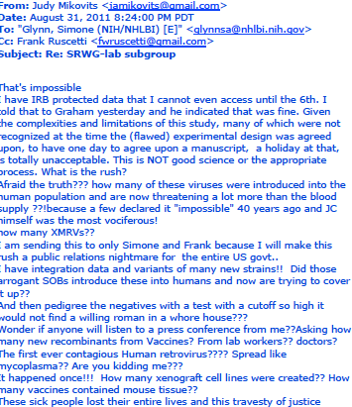
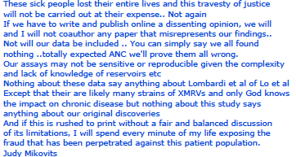
This email Brought a Phone Call And A Threat

Slide 9
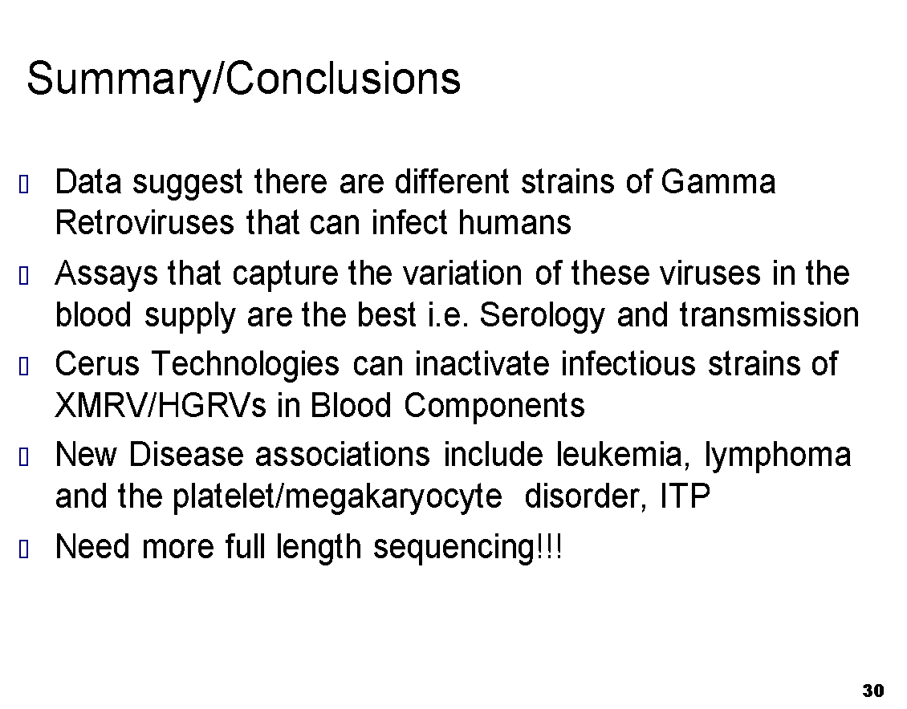
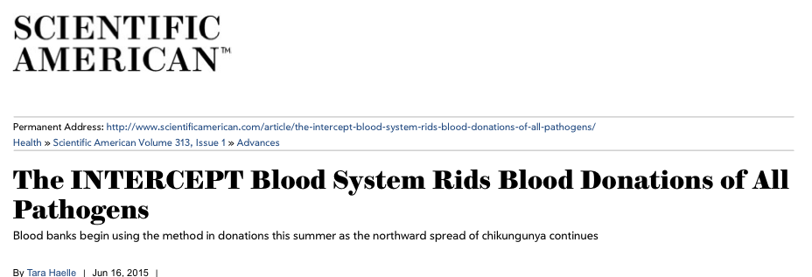
THE BLOOD Supply IS CONTAMINATED with MLV-related viruses!
_{NYAS} _{Mikovits March 29, 2011}
Antibodies to XMRV ENV Reproducibly Detected in 4-8 % Population In every single study!
FDA Approval December 1, 2014 of Intercept Blood System

Slide 10
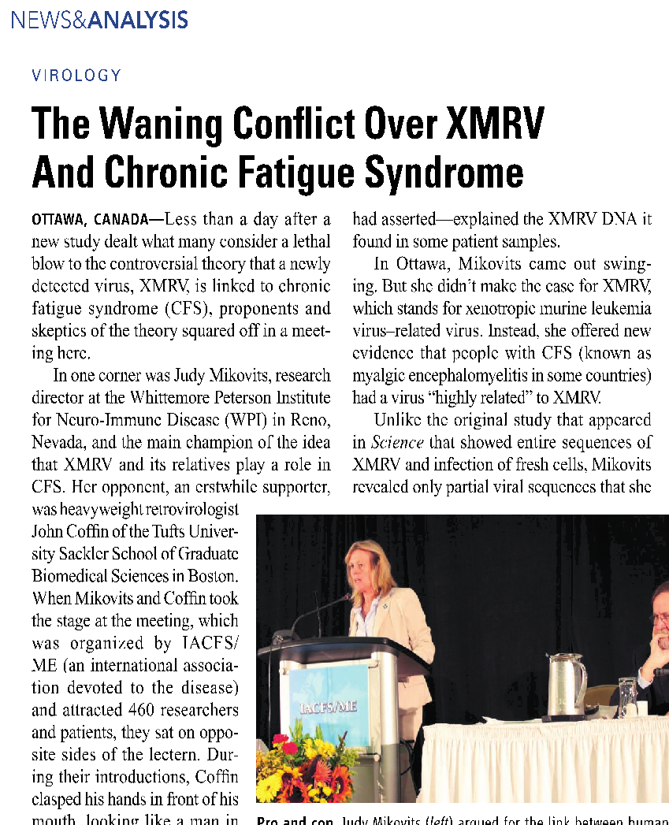
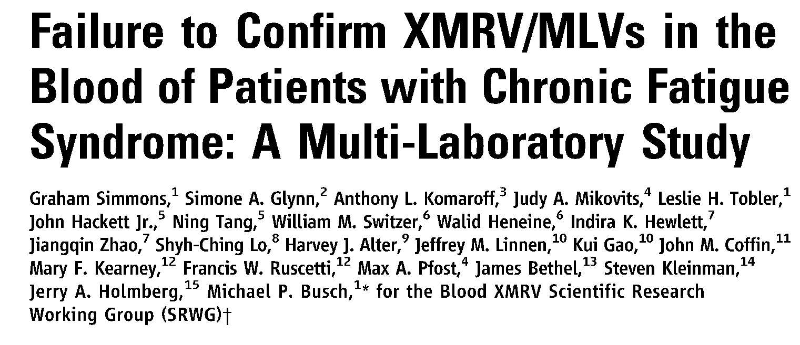
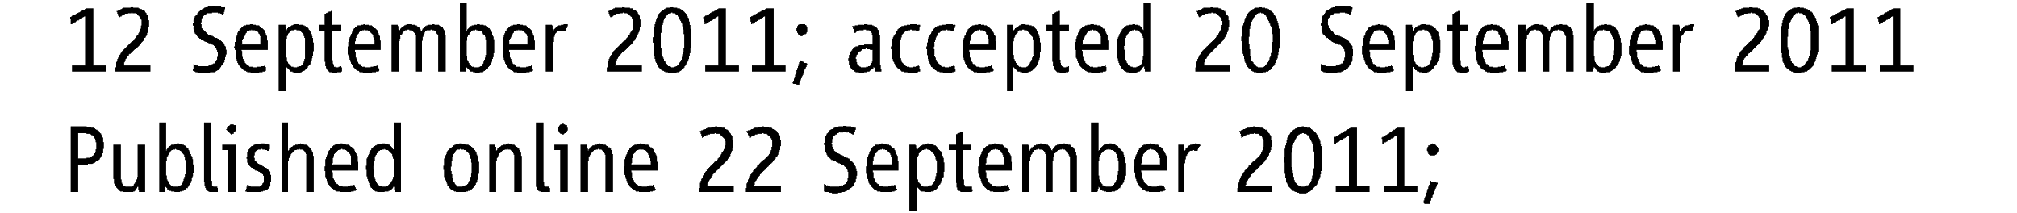
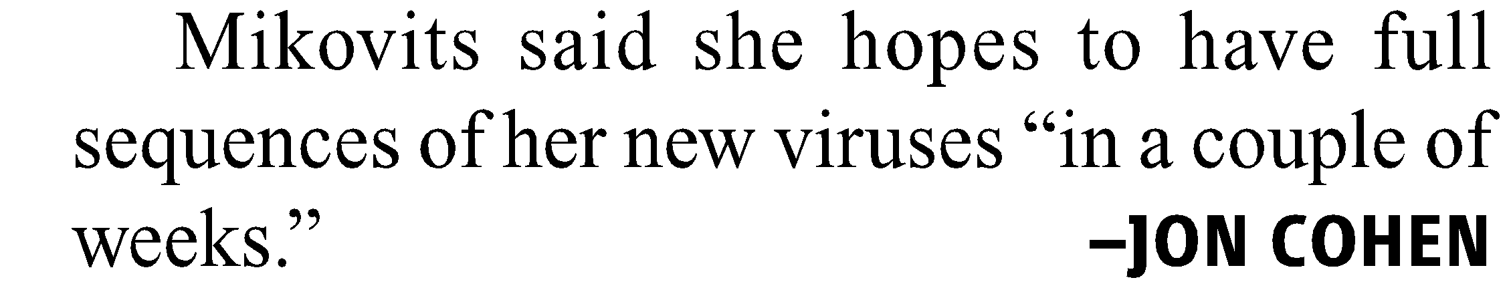
“Science Started this and Science is going to End This”
John Coffin to Frank Ruscetti, November 2010

Slide 11
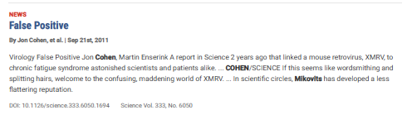
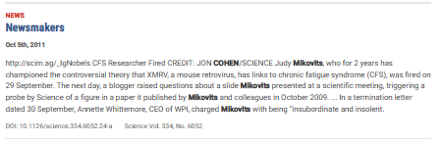
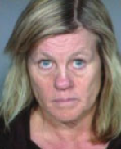
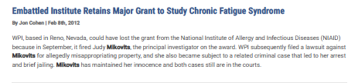
The Whittemores are forgiven their crimes in exchange for destroying the data Mikovits defends with Solid Science
When Max Pfost catches them In the act of setting up Mikovits on the night she is fired. Whittemores Unleash their power:
Controversial CFS Researcher Arrested and Jailed: By Jon Cohen Nov. 19, 2011
Sheriffs in Ventura County, California, arrested Mikovits yesterday on felony charges that she is a fugitive from justice. She is being held at the Todd Road Jail in Santa Paula without bail. But ScienceInsider could obtain only sketchy details about the specific charges against her. The Ventura County sheriff's office told ScienceInsider that it had no available details about the charges and was acting upon a warrant issued by Washoe County in Nevada. A spokesperson for the Washoe County Sheriff's Office told ScienceInsider that it did not issue the warrant, nor did the Reno or Sparks police department. He said it could be from one of several federal agencies in Washoe County.
AND ARE REWARDED!

Slide 12
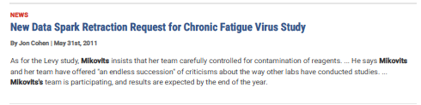
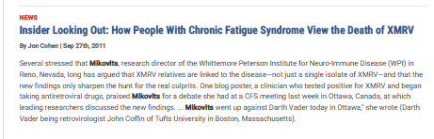
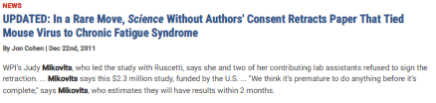
When I kept my promise, Science ended my career and those who participated in the fraud are REWARDED
Paper co-author Robert Silverman of the Cleveland Clinic Lerner College of Medicine of Case Western Reserve University sent this statement to Science Insider:
I requested a full retraction of our findings this summer after discovering that the blood samples were contaminated. I was in favor of a retraction of the entire paper at that time. I am pleased to see that the Journal has now granted a retraction of the entire paper, and I agree with that decision.

Slide 13
Scientific Fraud: Deliberately use wrong patients and change study AIM
“Designed to Fail”
Lipkin Multi-Center Study (2012) – The Great Debunker!!!!
  Medical or psychiatric condition that might be associated with fatigue
  Abnormal serum characteristics
  Abnormal thyroid functions
  Lyme disease spirochete
  Treponema pallidium (tapeworm)
  Hepatitis B or C virus
  HIV infection
“We found retroviruses in 85 percent of the sample pools. Again, it is very difficult to know whether this is clinically significant or not. And given the previous experience with retroviruses in chronic fatigue, I am going to be very clear in telling you, although I am reporting them in Professor Montoya’s samples, neither he, nor we, have concluded there is a relationship to disease.”
(Dr. Lipkin in a public conference call with the Centers for Disease Control, September 10, 2013)
Notes:
Define Scientific Fraud
Just as in the blood working group publication and the Thompson Fraud..this is Fraud
Both studies excluded the very patients who would have been found to be infected!
(For ridiculous reasons)
Tell Bill’s story!
Its interesting that John Coffin said the same thing in 1980…we found sequences ..he put them in the supplemental data and

Slide 14
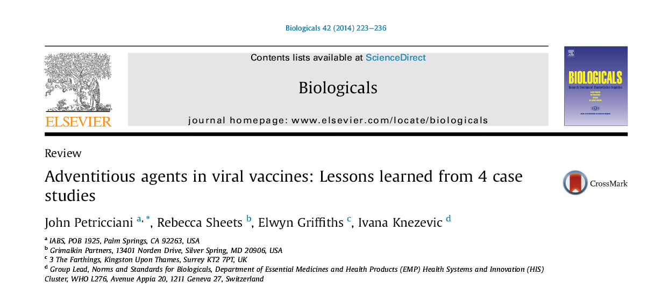
"However, the group also recommended that further studies be
Undertake urgently and internationally to put into perspective
the very low levels of RT activity found in the vaccines."
4.1. Initial findings
The discovery in 1995 of reverse transcriptase (RT) activity in marketed measles, mumps and rubella (MMR) vaccine raised concerns that the vaccine was contaminated by an unrecognized avian retrovirus with unknown safety implications.
4.2. Background
The usual flow of genetic information is from DNA to RNA. However, the reverse of that process was discovered to be mediated by an RNA-dependent DNA polymerase (reverse transcriptase) that some RNA viruses, such as retroviruses, use to reverse-transcribe their RNA genomes into DNA. That viral DNA can then be integrated into the host genome and replicated, resulting in the production of more RNA virus. RT activity has therefore been used as a biochemical marker for the presence of retroviruses. However, the
genes that encode RT are widely distributed in eukaryotic organisms and all reverse transcriptases are evolutionarily related. In addition, cellular DNA-directed DNA polymerases can exhibit some ability to use RNA as a template and reverse-transcribe as well.

Slide 15
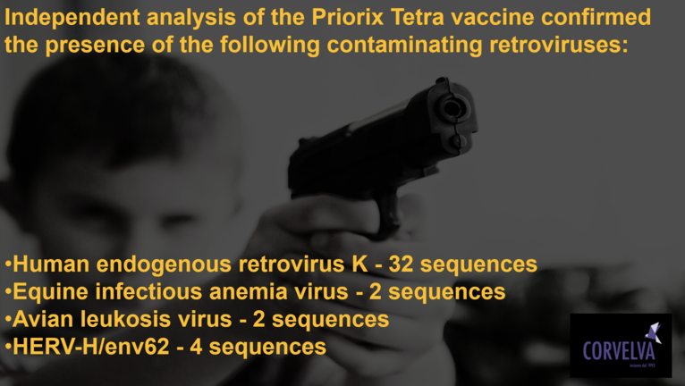
These viruses are known to be adventitious vaccine contaminants and are known to ​be potentially dangerous, which is why manufacturers are required to verify that they are completely absent from the vaccine.
The presence of potentially dangerous adventitious viruses ​which certifies that there is no adequate control on vaccines because if there were, these elements would have been detected.
Residual DNA/RNA deriving from cultured cells - Total amount of DNA: 1.7-3.7 μg/dose, the 80%
of which was human (Human fetal DNA / RNA from the MRC-5 cell line). Other amount of DNA: chicken

Slide 16
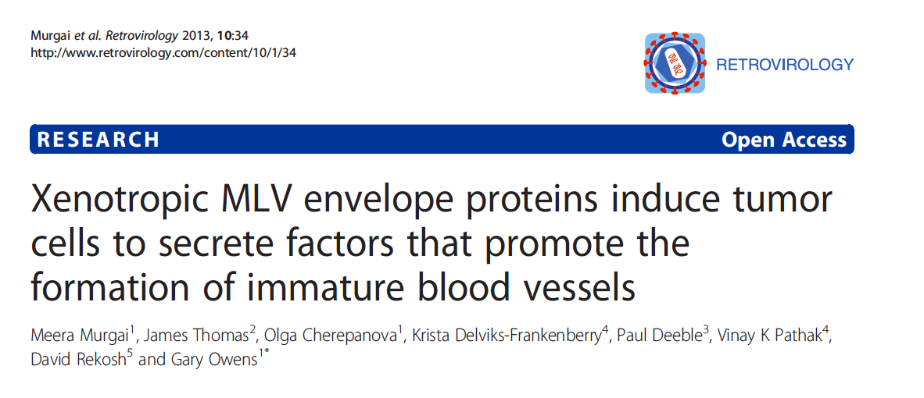
INFECTIOUS VIRUS IS NOT NECESSARY TO CAUSE DISEASE
ENV proteins from both viruses impact tumor pathogenesis (change microvasculature)
Similarities to Vascular Pathologies seen in ME/CFS
& Vaccine injuries
Microvasculature aberrations caused solely by XMRV ENV protein
“Although it is highly unlikely that either XMRV VP62 or B4Rv themselves infect humans and are pathogenic, the results suggest that xenograft approaches commonly used in these studies of human cancer promote the evolution of novel retroviruses with pathogenic properties. Similar retroviruses may have evolved to infect humans!”

Slide 18
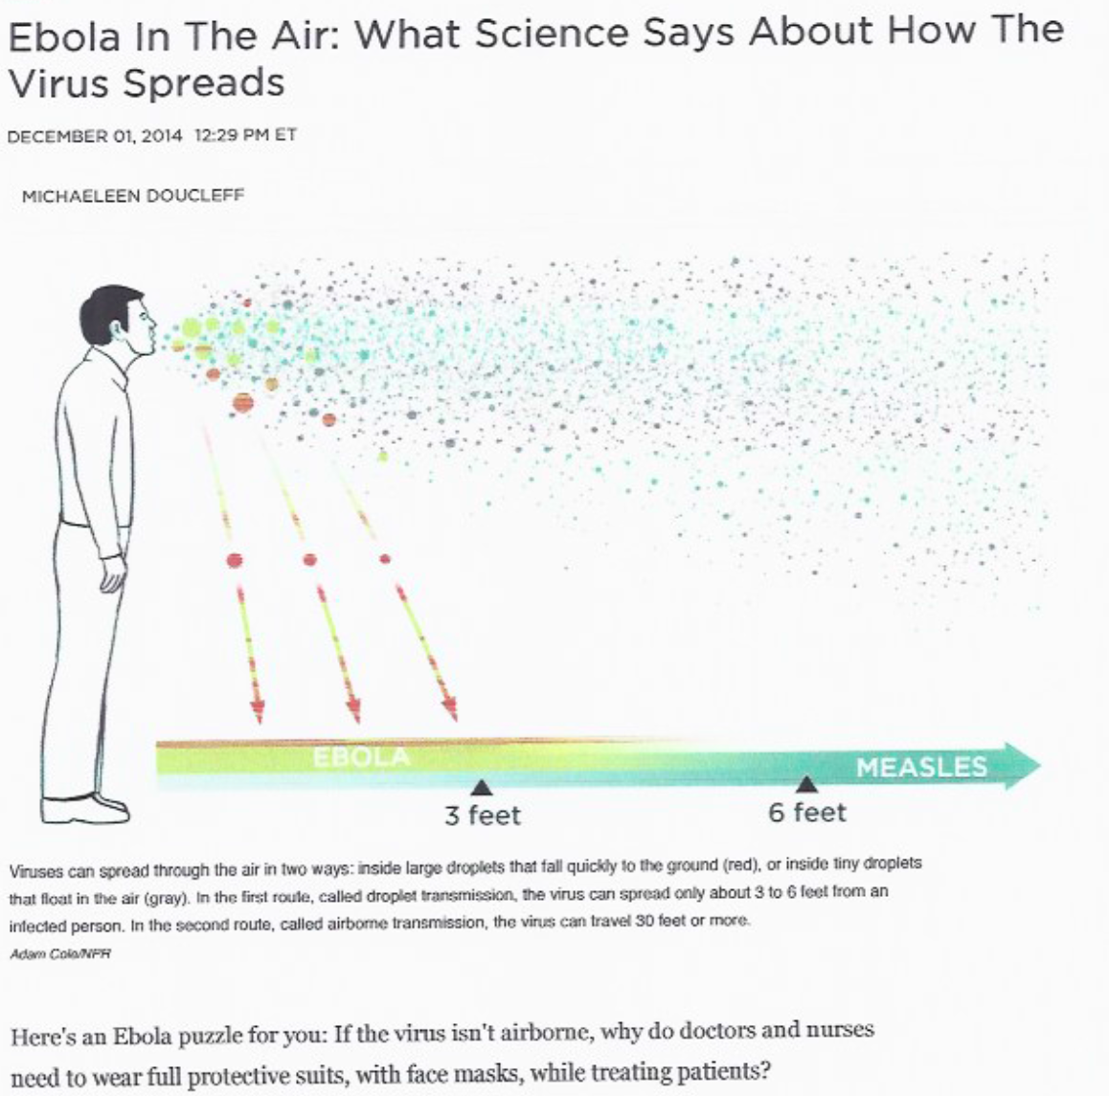
Harold Varmus was NIH Director who implemented the xenotransplantation program in 1999. This included xenografts for cancer research, gene therapy. Varmus also started the NIH Vaccine Research Program.
Many infectious diseases of animals can be transmitted to humans via routine exposure to or consumption of animals (e.g., rabies). Viruses that are not pathogenic in their natural host reservoirs may, in some cases, be highly pathogenic when transmitted to a new host species. Several zoonotic viruses have produced significant outbreaks when introduced into human hosts under normal circumstances of exposure (e.g., Ebola, Hanta Virus, Influenza).
Consequently, the recipient of a xenotransplant is potentially at risk for infection with infectious agents already known to be transmissible from animals to humans as well as with infectious agents, which may become transmissible only through xenotransplantation and which may not be readily identified with current diagnostic tools. Infected xenograft recipients could then potentially transmit these infectious agents to their contacts and subsequently to the public at large.

Slide 19

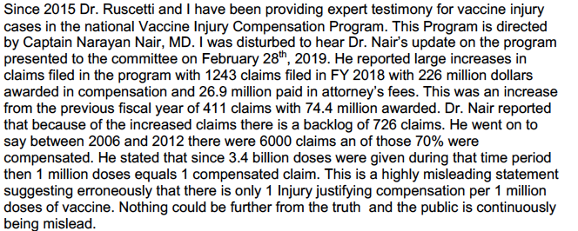
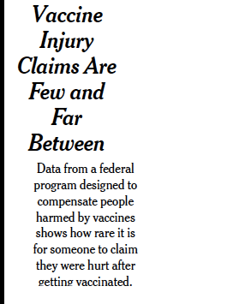
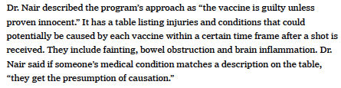
National Vaccine Injury Compensation Program: BEYOND CORRUPTION
June 18, 2019

Slide 20
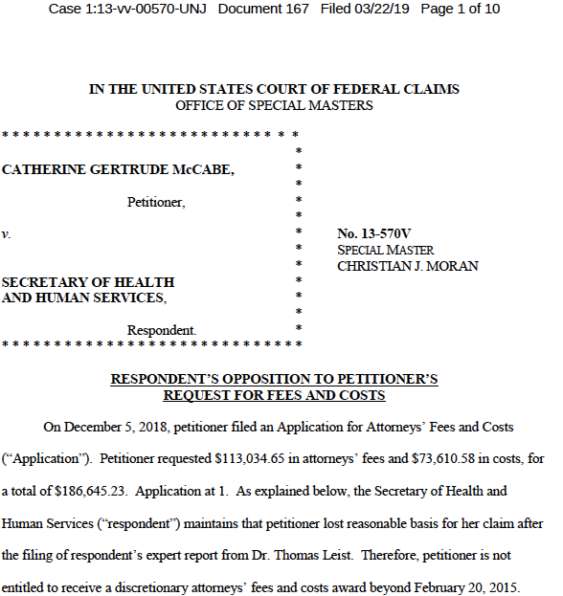
HHS And DOJ Committing Federal Crimes Against Innocent Victims:
Vaccines Are Presumed Innocent at all Costs.
The True Costs Buried with The Victims Of Unsafe and Untested Vaccine

Slide 21
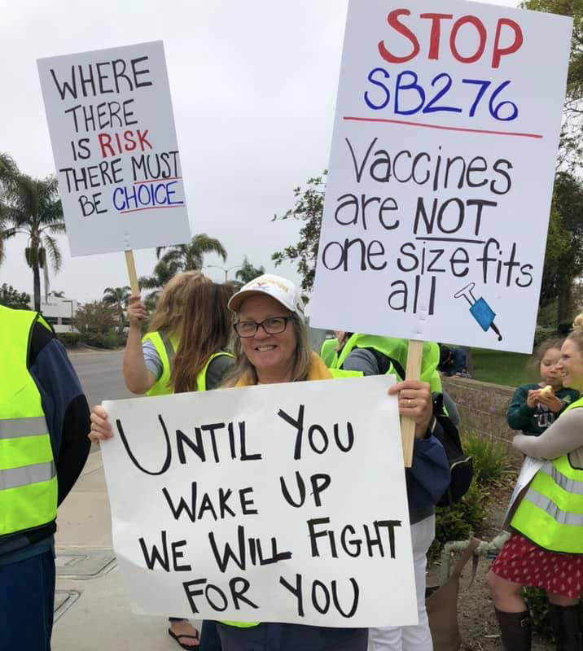
Call To Action
Repeal 1986 National Vaccine Injury Compensation Act
Enact immediate Moratorium on ALL Vaccines Until All and the entire Vaccine Schedule Is Safety Tested
End all Mandates and Restore Liability to all
Convict criminals at CDC, FDA, NIH for crimes against humanity
Eliminate Advisory Committee on Immunization Practices (ACIP)
Use NIH and CDC & FDA Patent Royalties to Compensate all Victims of this 35 Year Plague Of Corruption

